Slide 1


Mixed plain boundary value problem of elasticity FOR A rectangular domain
N. Vaysfeld, D. Nerukh, O. Pozhylenkov

Slide 2
Structure of the report
1) Review
2) Problem statement
3) Problem solving
4) Analytical solution in the transforms domain
5) Two subcases of the stated problem
6) Numerical results
7) Conclusion notes

Slide 3
Review
Shyam N. Prasad, Sailendra N. Chatterjee. (1973) Some mixed boundary value problems of elasticity in a rectangular domain.
Popov G. (1982) The elastic stress concentration around dies, cuts, thin inclusions and reinforcements.
Vihak V. M., Yuzvyak M. Y., Yasinskij A. V. (1998) The solution of the plane thermoelasticity problem for a rectangular domain.
Vihak V. M., Tokovyy Yu. (2002) Construction elementary solutions of the elasticity plane problem for the rectangular domain.

Slide 4
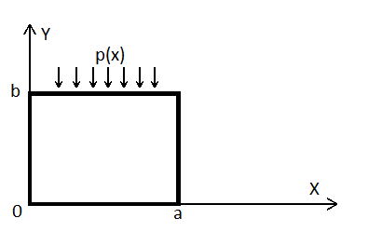
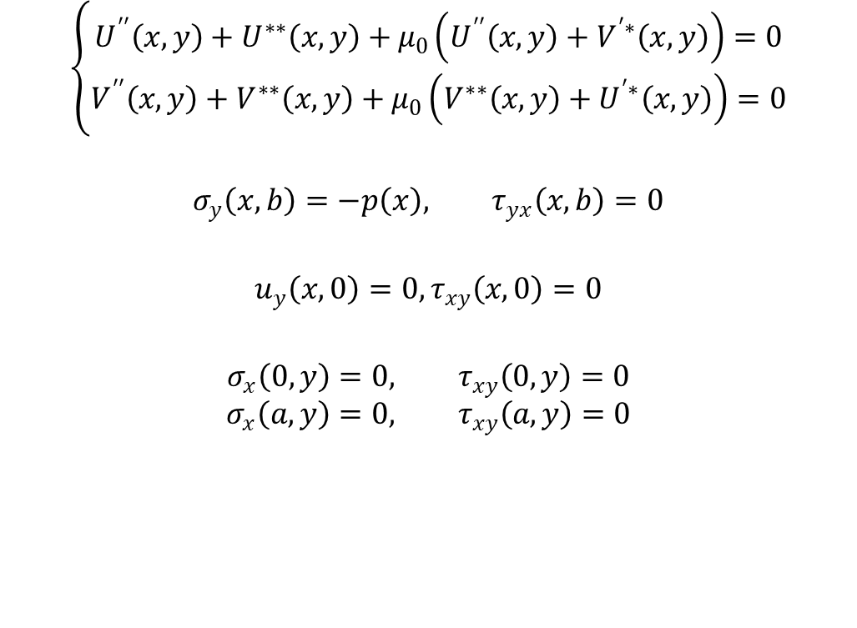
Problem statement
$$\left\{\begin{aligned}U^{′′}\left(x,y\right)+U^{∗∗}\left(x,y\right)+μ_{0}\left(U^{′′}\left(x,y\right)+V^{′∗}\left(x,y\right)\right)=0 \\ V^{′′}\left(x,y\right)+V^{∗∗}\left(x,y\right)+μ_{0}\left(V^{∗∗}\left(x,y\right)+U^{′∗}\left(x,y\right)\right)=0\end{aligned}\right.$$
$$σ_{y}\left(x,b\right)=−p\left(x\right), τ_{yx}\left(x,b\right)=0$$
$$u_{y}\left(x,0\right)=0, τ_{xy}\left(x,0\right)=0$$
$$σ_{x}\left(0,y\right)=0, τ_{xy}\left(0,y\right)=0$$
$$σ_{x}\left(a,y\right)=0, τ_{xy}\left(a,y\right)=0$$

Slide 5

Problem solving
Using the Fourier`s transforms:
$$\left(\begin{aligned}U_{n}(y) \\ V_{n}(y)\end{aligned}\right)=\int_{0}^{a}{\left(\begin{aligned}U\left(x,y\right)∗sin⁡(α_{n}x) \\ V\left(x,y\right)∗cos⁡(α_{n}x)\end{aligned}\right)dx}, α_{n}=\frac{πn}{a}$$
Vector boundary state problem in the transforms:
$$L_{2}\left(Z_{n}\left(y\right)\right)=f_{n}\left(y\right)$$
$$U_{i}\left(Z_{n}\left(y\right)\right)=0, i=1,2$$
Here:
$$L_{2}\left(Z_{n}\left(y\right)\right)=IZ_{n}^{′′}\left(y\right)+PZ_{n}^{′}\left(y\right)+QZ_{n}(y)$$
$$U_{i}\left(Z_{n}\left(y\right)\right)=A_{i}Z_{n}^{′}\left(b_{i}\right)+B_{i}Z_{n}\left(b_{i}\right), b_{1}=0, b_{2}=b$$

Slide 6

Problem solving
The fundamental solution matrix:
$$Y\left(y\right)=\frac{1}{2πi}\oint_{C}{e^{ξy}M^{−1}\left(ξ\right)dξ}$$
where $M\left(ξ\right)$ matrix was found using:
$L_{2}e^{ξy}I=M\left(ξ\right)e^{ξy}$
$$Y_{0n}\left(y\right)=\frac{e^{α_{n}y}}{4α_{n}\left(1+μ_{0}\right)}\left(\begin{matrix}μ_{0}α_{n}y+μ_{0}+2 & μ_{0}y \\ −μ_{0}y & −μ_{0}α_{n}y+μ_{0}+2\end{matrix}\right)$$
$$Y_{1n}\left(y\right)=\frac{e^{−α_{n}y}}{4α_{n}\left(1+μ_{0}\right)}\left(\begin{matrix}μ_{0}α_{n}y+3μ_{0}+2 & μ_{0}α_{n}y+2μ_{0} \\ {−μ}_{0}α_{n}y−2μ_{0} & −μ_{0}α_{n}y−μ_{0}+2\end{matrix}\right)$$

Slide 7

Analytical solution in the transforms domain
Exact solution in the transform`s domain:
$$Z_{n}\left(y\right)=Y_{0n}\left(y\right)\left(\begin{aligned}C_{1} \\ C_{2}\end{aligned}\right)+Y_{1n}\left(\begin{aligned}C_{3} \\ C_{4}\end{aligned}\right)+ \int_{0}^{b}{G\left(y,ξ\right)}f_{n}\left(ξ\right)dξ$$
Where:
$$G\left(y,ξ\right)=\frac{2}{b}\sum_{n=0 }^{∞}{′H\left(y,α_{n}\right)Ω^{−1}\left(α_{n}\right)H(ξ,α_{n})}$$

Slide 8
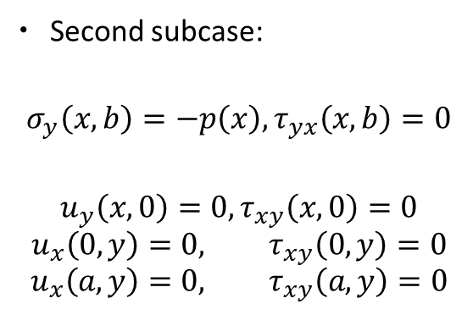
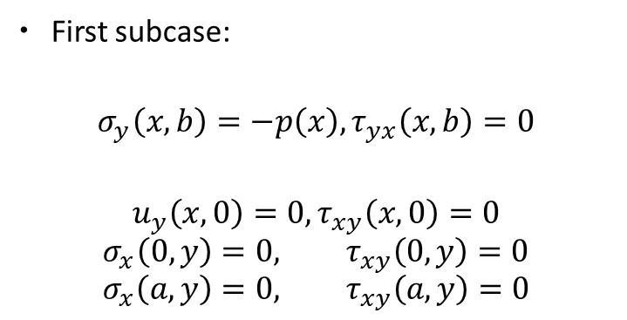
Two subcases of the stated problem
First subcase:
$$σ_{y}\left(x,b\right)=−p\left(x\right), τ_{yx}\left(x,b\right)=0$$
$$u_{y}\left(x,0\right)=0, τ_{xy}\left(x,0\right)=0$$
$$σ_{x}\left(0,y\right)=0, τ_{xy}\left(0,y\right)=0$$
$$σ_{x}\left(a,y\right)=0, τ_{xy}\left(a,y\right)=0$$
Second subcase:
$$σ_{y}\left(x,b\right)=−p\left(x\right), τ_{yx}\left(x,b\right)=0$$
$$u_{y}\left(x,0\right)=0, τ_{xy}\left(x,0\right)=0$$
$$u_{x}\left(0,y\right)=0, τ_{xy}\left(0,y\right)=0$$
$$u_{x}\left(a,y\right)=0, τ_{xy}\left(a,y\right)=0$$

Slide 9
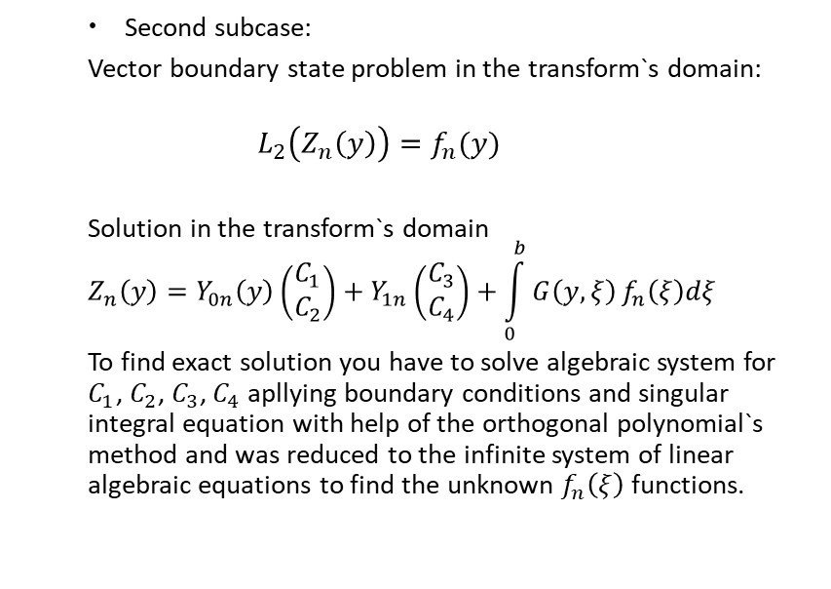
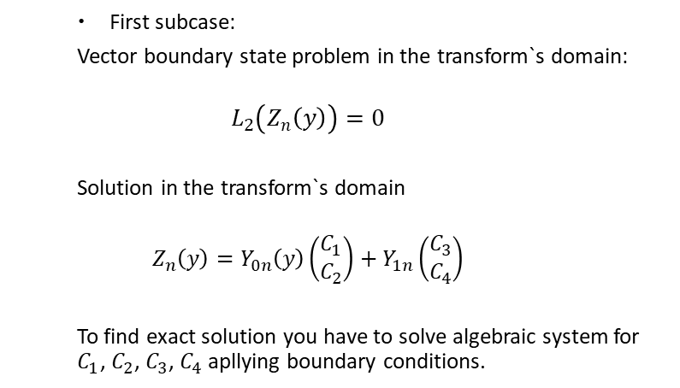
Two subcases of the stated problem
First subcase:
Vector boundary state problem in the transform`s domain:
$$L_{2}\left(Z_{n}\left(y\right)\right)=0$$
Solution in the transform`s domain
$$Z_{n}\left(y\right)=Y_{0n}\left(y\right)\left(\begin{aligned}C_{1} \\ C_{2}\end{aligned}\right)+Y_{1n}\left(\begin{aligned}C_{3} \\ C_{4}\end{aligned}\right)$$
To find exact solution you have to solve algebraic system for $C_{1}$, $C_{2}$, $C_{3}$, $C_{4}$ apllying boundary conditions.
Second subcase:
Vector boundary state problem in the transform`s domain:
$$L_{2}\left(Z_{n}\left(y\right)\right)=f_{n}(y)$$
Solution in the transform`s domain
$$Z_{n}\left(y\right)=Y_{0n}\left(y\right)\left(\begin{aligned}C_{1} \\ C_{2}\end{aligned}\right)+Y_{1n}\left(\begin{aligned}C_{3} \\ C_{4}\end{aligned}\right)+\int_{0}^{b}{G\left(y,ξ\right)}f_{n}\left(ξ\right)dξ$$
To find exact solution you have to solve algebraic system for $C_{1}$, $C_{2}$, $C_{3}$, $C_{4}$ apllying boundary conditions and singular integral equation with help of the orthogonal polynomial`s method and was reduced to the infinite system of linear algebraic equations to find the unknown $f_{n}\left(ξ\right)$ functions.

Slide 10
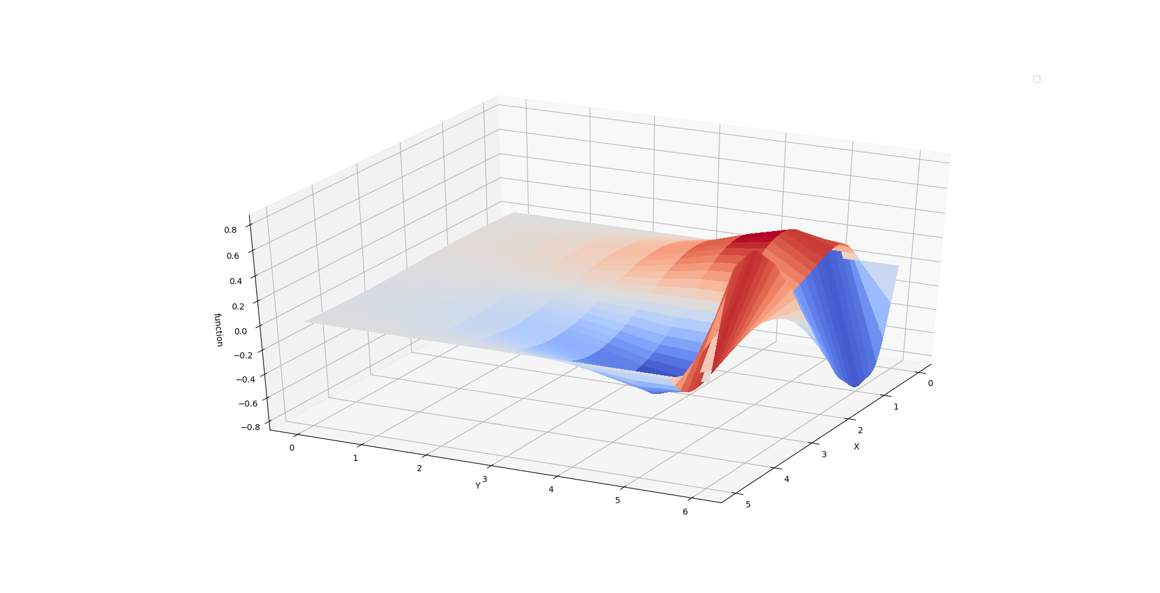
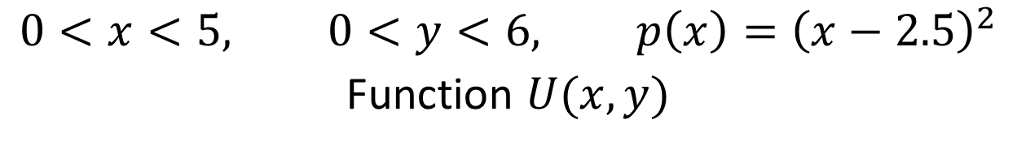
Numerical results
$$0<x<5, 0<y<6, p\left(x\right)={\left(x−2.5\right)}^{2}$$
Function $U(x,y)$

Slide 11
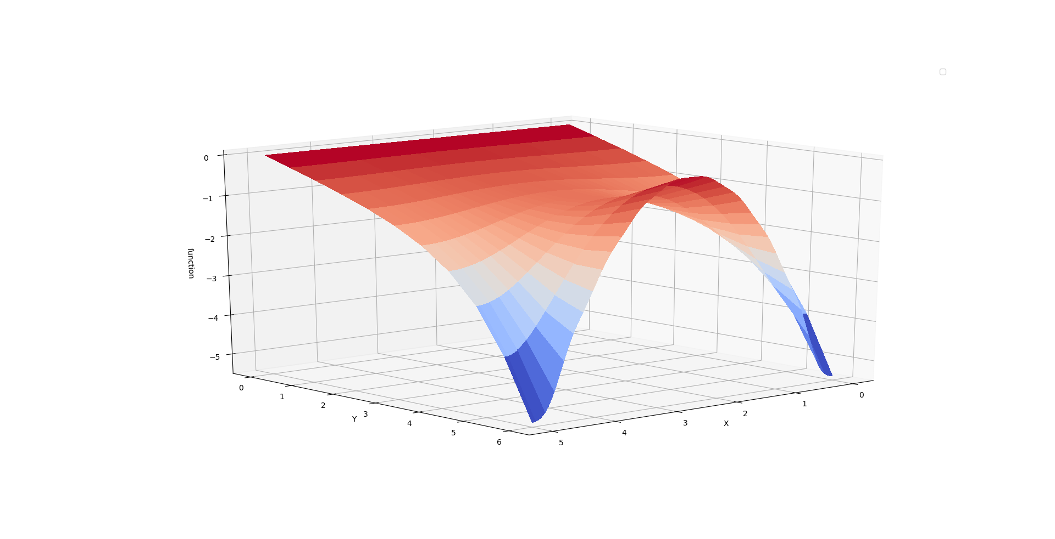
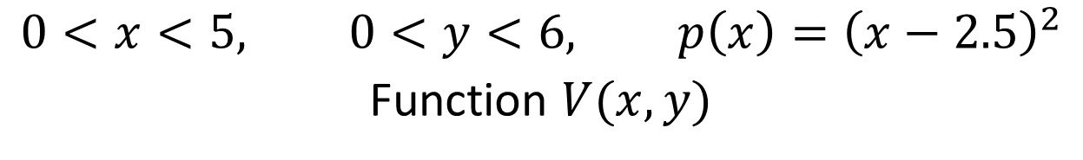
$$0<x<5, 0<y<6, p\left(x\right)={\left(x−2.5\right)}^{2}$$
Function $V(x,y)$

Slide 12
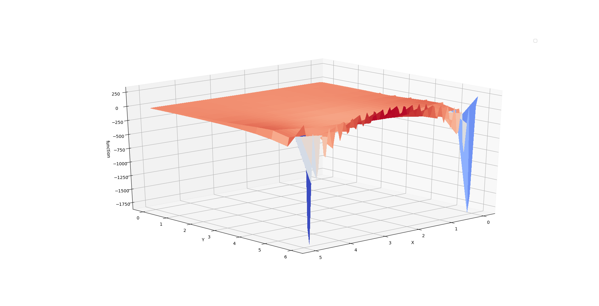
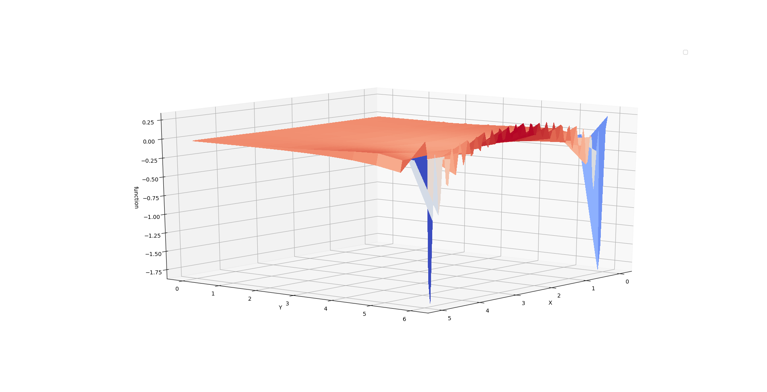
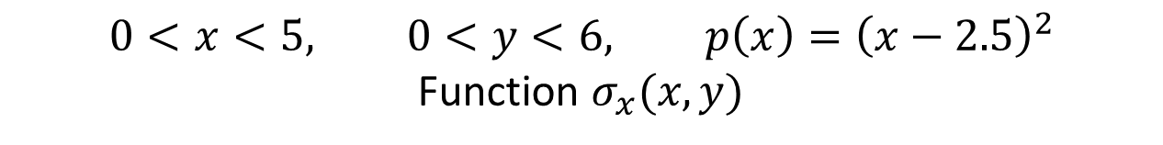
$$0<x<5, 0<y<6, p\left(x\right)={\left(x−2.5\right)}^{2}$$
Function $σ_{x}(x,y)$

Slide 13
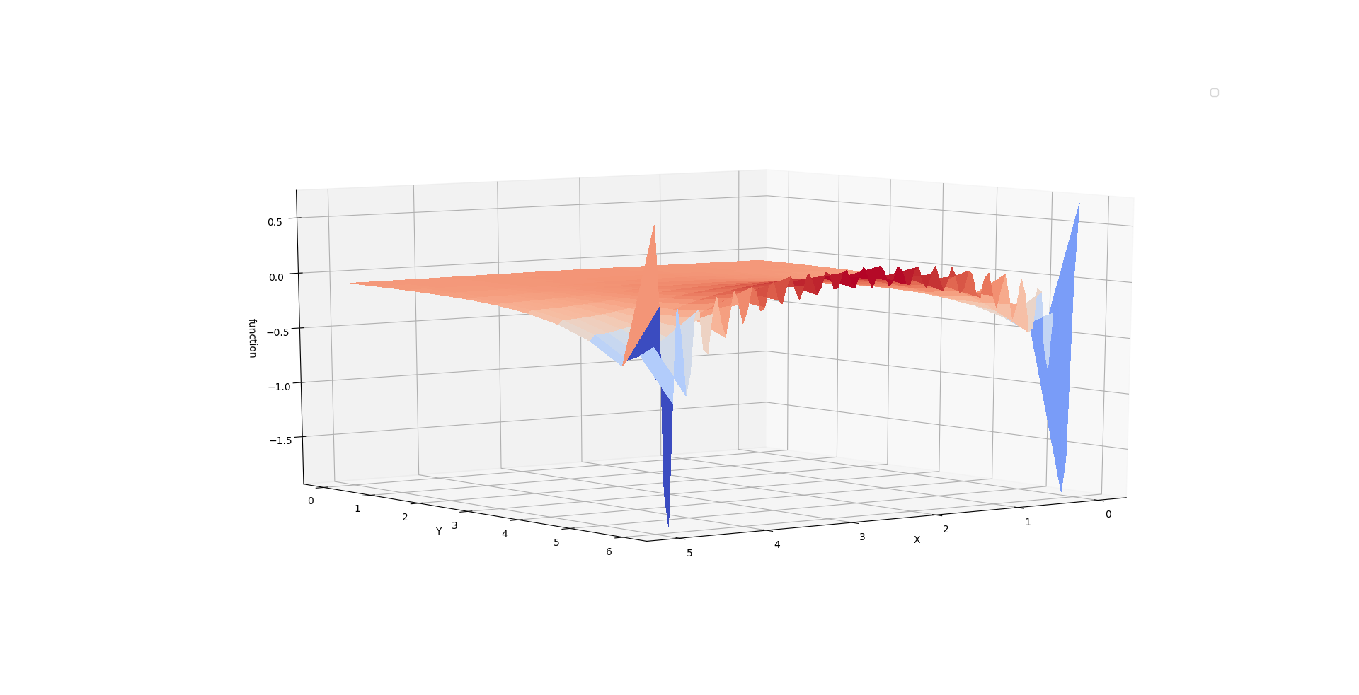
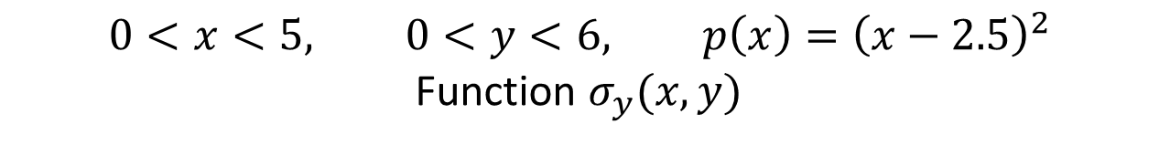
$$0<x<5, 0<y<6, p\left(x\right)={\left(x−2.5\right)}^{2}$$
Function $σ_{y}(x,y)$

Slide 14
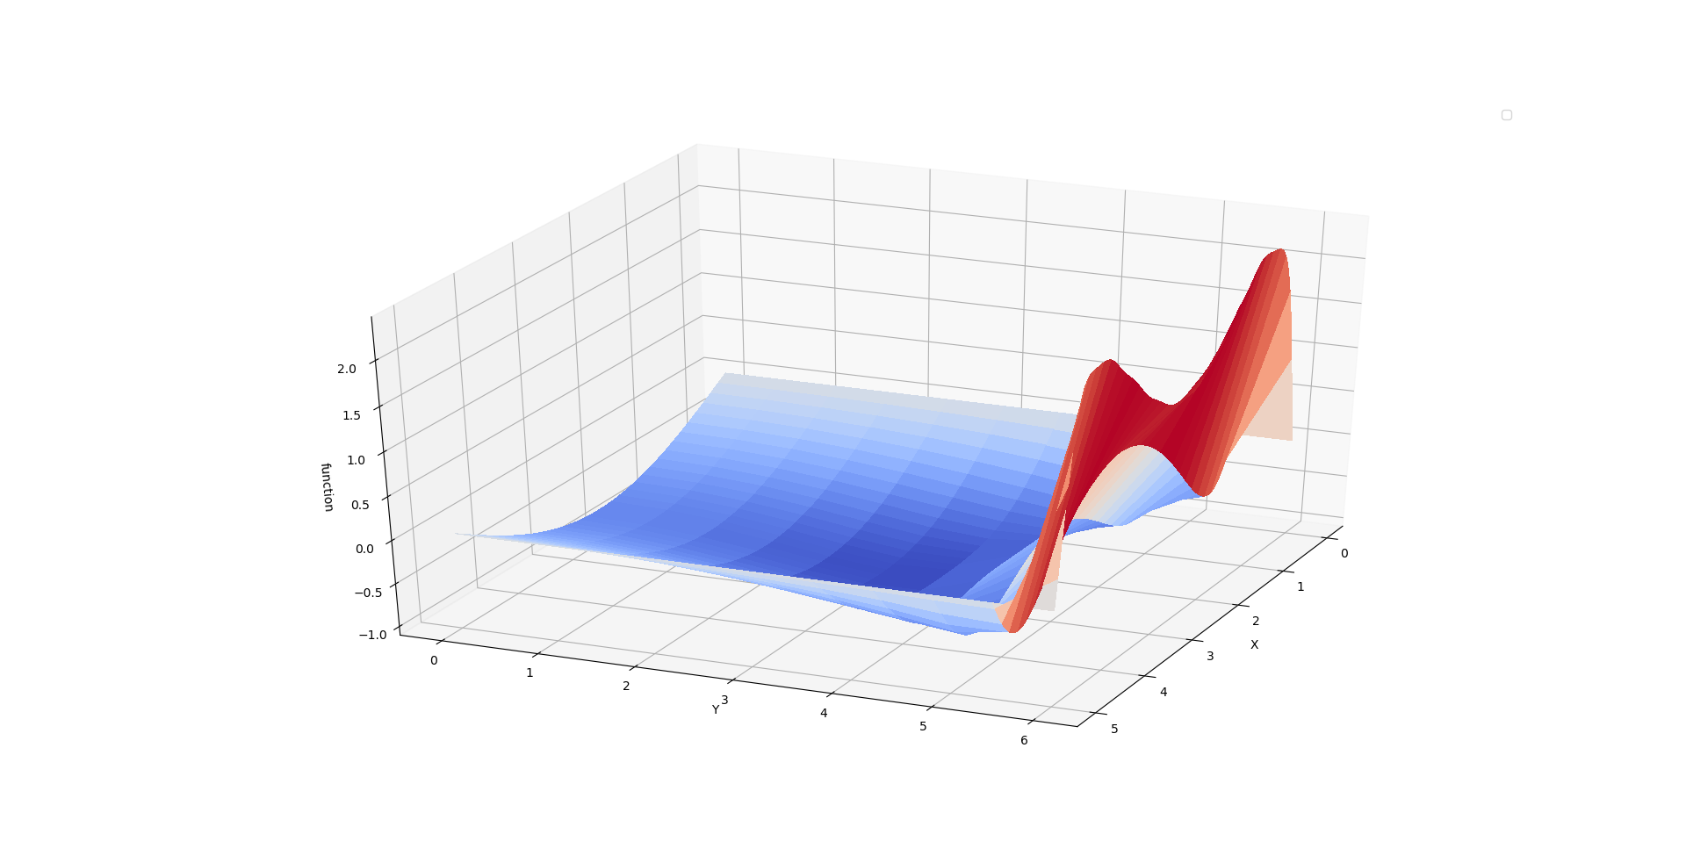
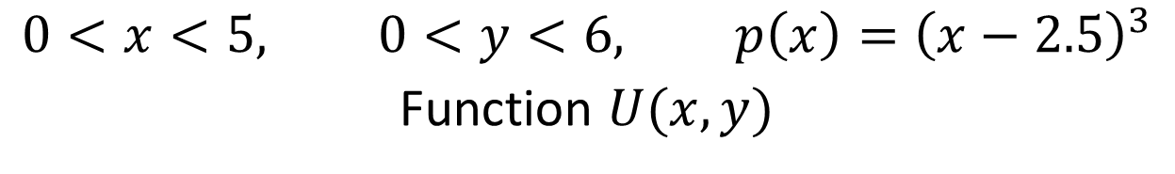
$$0<x<5, 0<y<6, p\left(x\right)={\left(x−2.5\right)}^{3}$$
Function $U(x,y)$

Slide 15
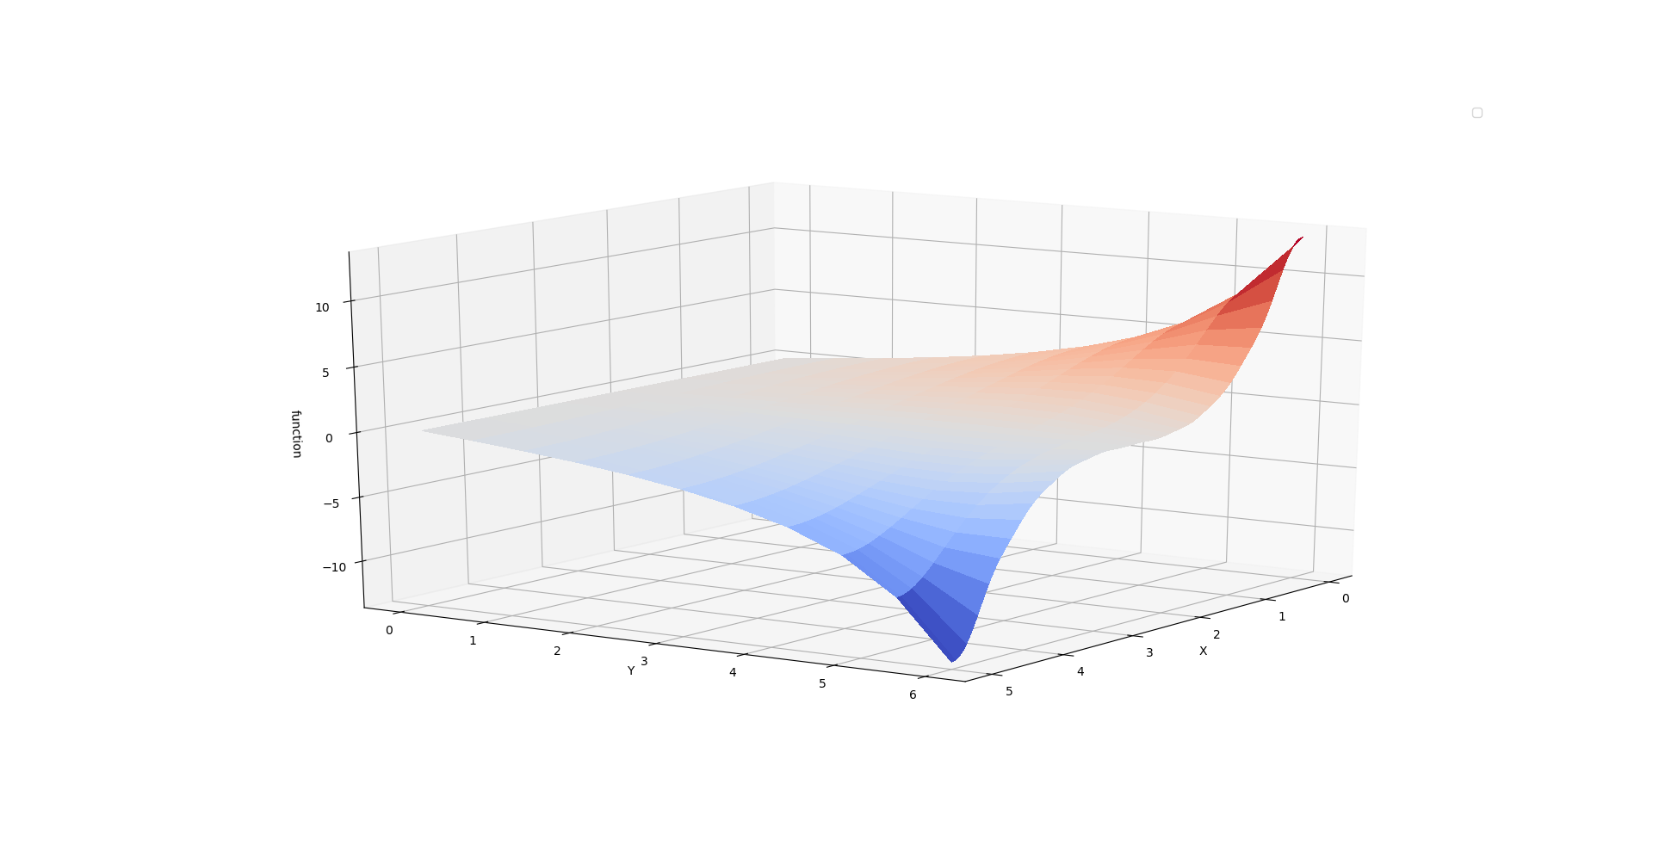
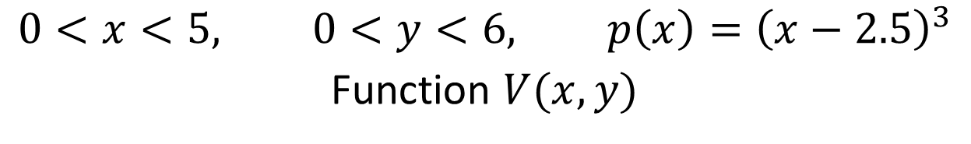
$$0<x<5, 0<y<6, p\left(x\right)={\left(x−2.5\right)}^{3}$$
Function $V(x,y)$

Slide 16
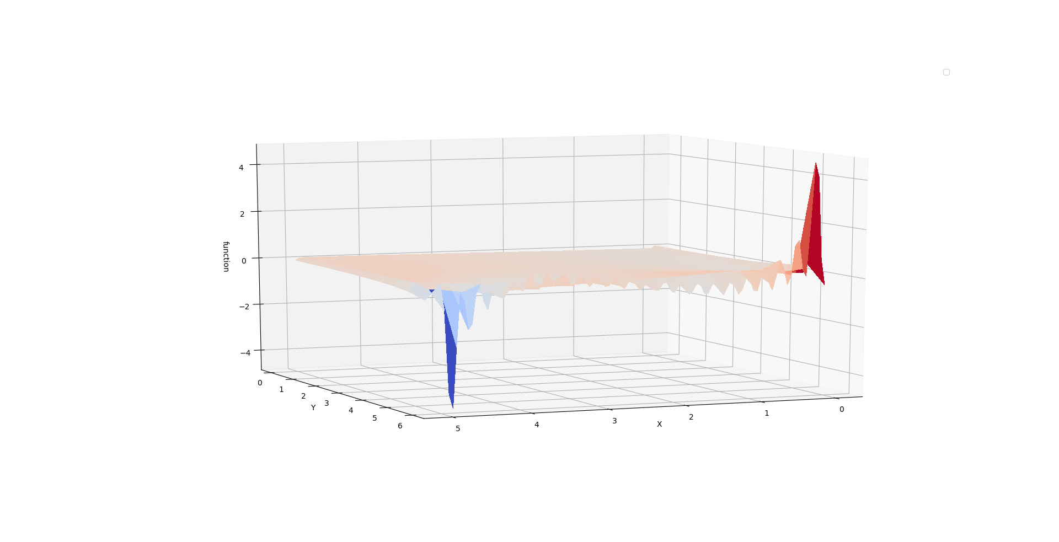
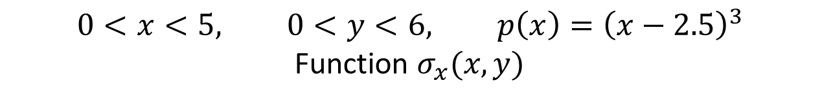
$$0<x<5, 0<y<6, p\left(x\right)={\left(x−2.5\right)}^{3}$$
Function $σ_{x}(x,y)$

Slide 17
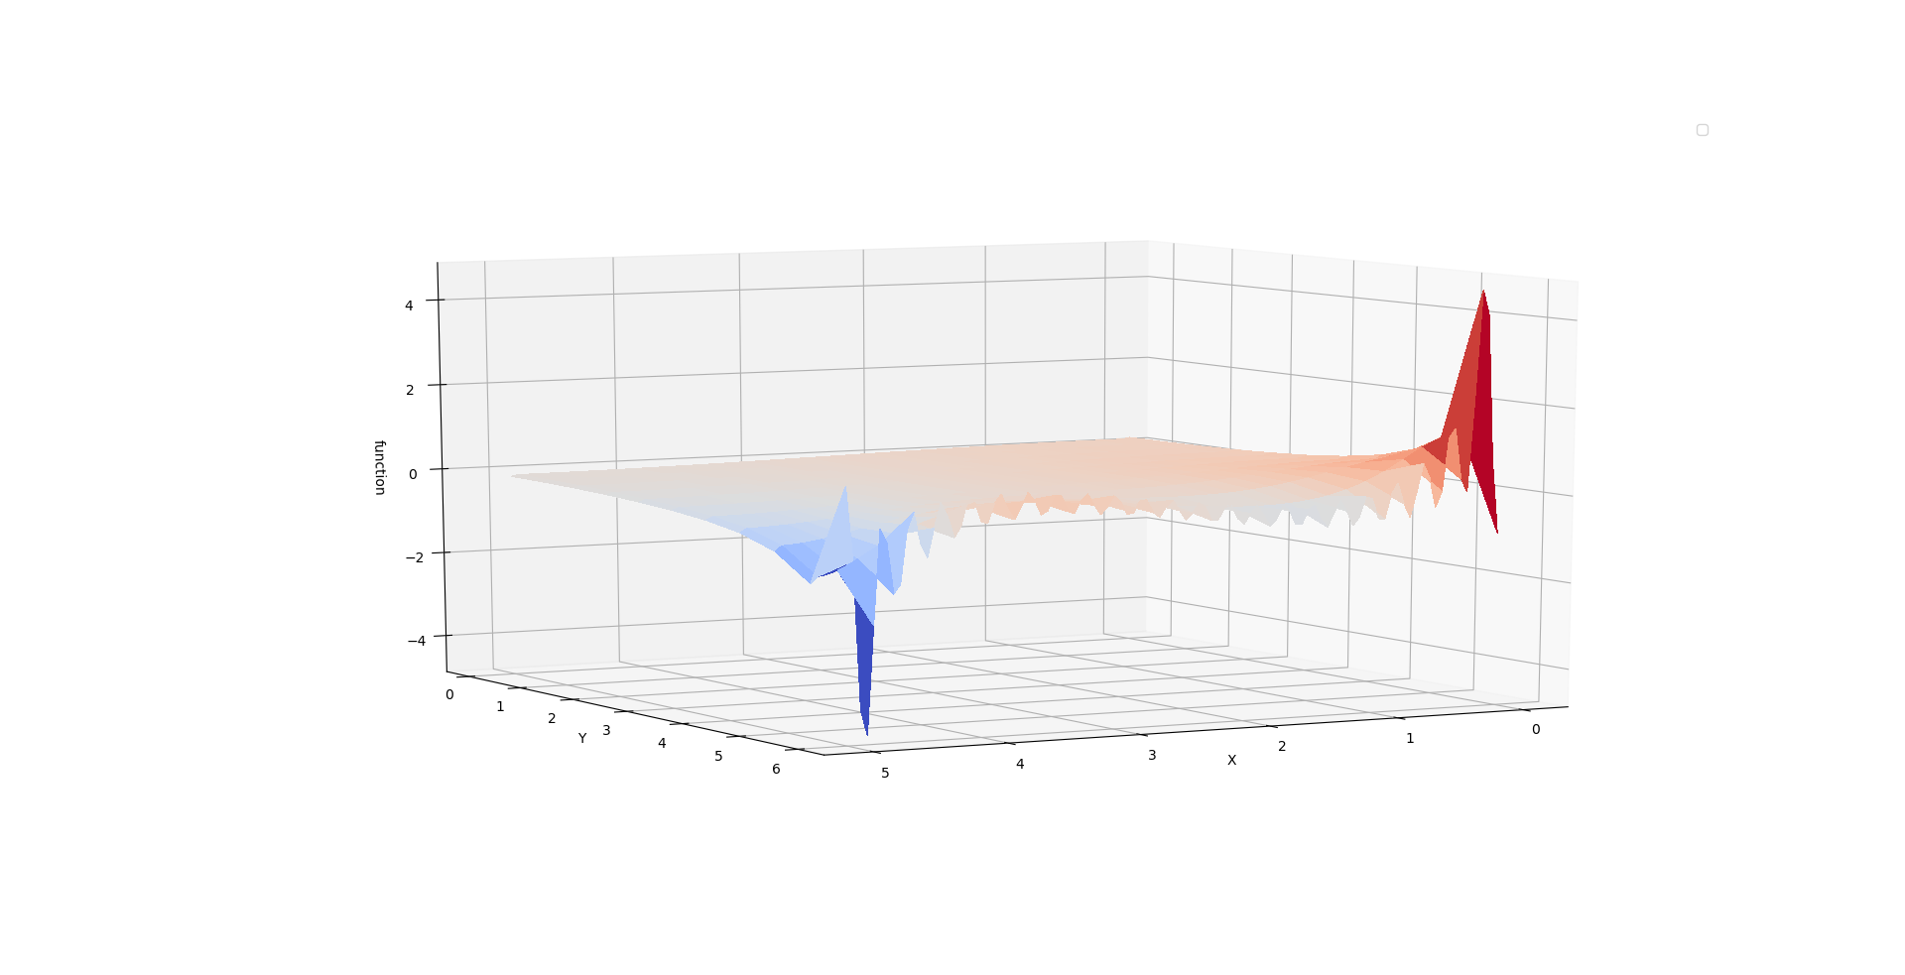
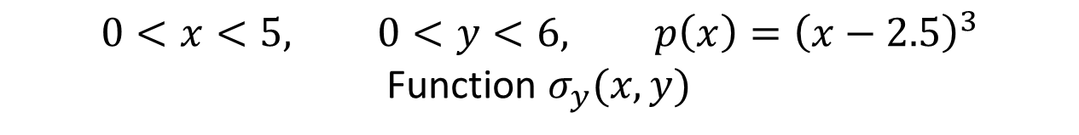
$$0<x<5, 0<y<6, p\left(x\right)={\left(x−2.5\right)}^{3}$$
Function $σ_{y}(x,y)$

